Slide 1

Real-time sentiment analysis on streaming data
Presented By Rohan N. Jadhao Guided By Prof. Dr. S. S. Dhande

Slide 2
Content
Introduction
Streaming Data in Sentiment Analysis
Challenges in Real-time Sentiment Analysis
Techniques for Real-time Sentiment Analysis
Performance Metrics for Real-time Sentiment Analysis
Real-world Applications
Future Directions
Conclusion
References

Slide 3
Introduction
Welcome to our presentation on "Real-Time Sentiment Analysis on Streaming Data."
Sentiment analysis helps us understand the emotions in text data, and it has become essential in natural language processing.
While traditional models analyze static text, the rise of streaming data from social media and news feeds has driven the demand for real-time sentiment analysis.

Slide 4
Real-time sentiment analysis is about continuously analyzing streaming data to detect emotions and opinions in the moment.
In this presentation, we'll explore the challenges and techniques for implementing sentiment analysis in streaming data.
We'll also discuss different real-time sentiment analysis architectures and how they are used in various fields.

Slide 5
Streaming Data in Sentiment Analysis
Streaming Data: It's continuous and high-velocity data from sources like social media, news feeds, and IoT devices.
Real-time Sentiment Analysis: Analyzing streaming data to get current insights on emotions and opinions.

Slide 6
Challenges in Real-time Sentiment Analysis
High Volume: Managing large amounts of data arriving continuously.
Velocity: Processing data rapidly to keep up with its flow.
Variety: Handling data from different sources and formats.
Volatility: Adapting to real-time changes in sentiment.

Slide 7
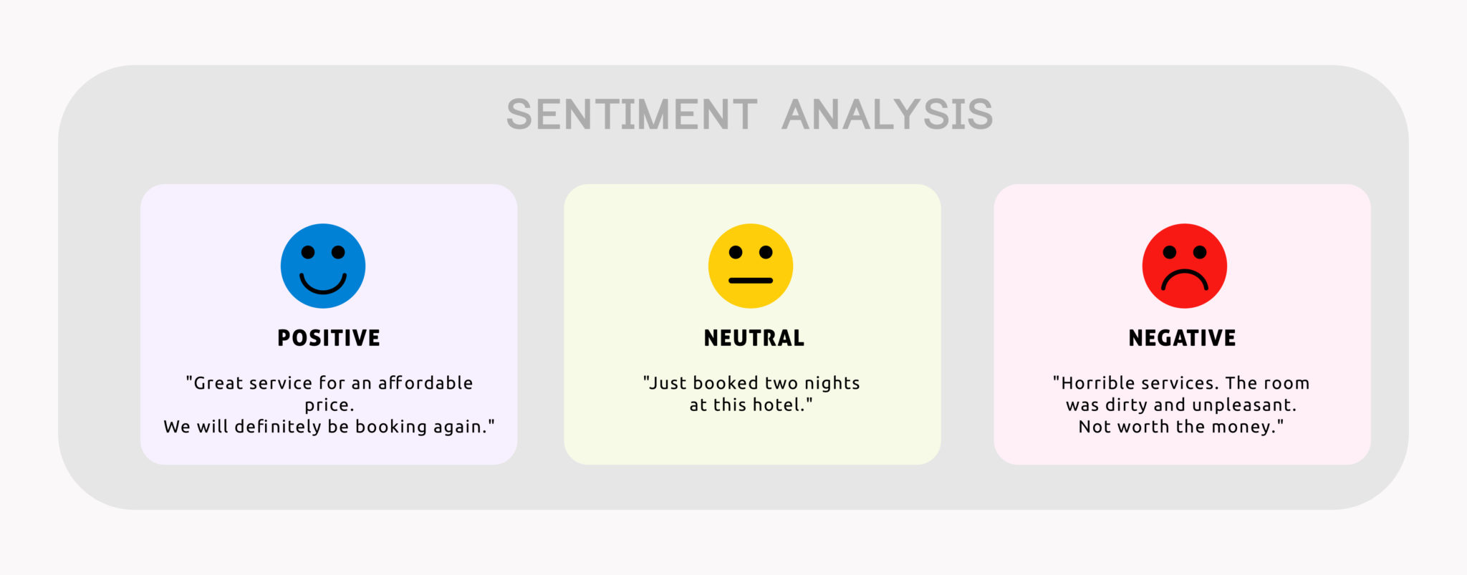
Example:

Slide 8
Techniques for Real-time Sentiment Analysis
Pre-processing: Cleaning and preparing streaming data for sentiment analysis.
Online Machine Learning: Using adaptive algorithms for changing sentiment patterns.
Incremental Models: Building models that can be updated with new data.
Distributed Processing: Scalable real-time analysis with distributed systems.

Slide 9
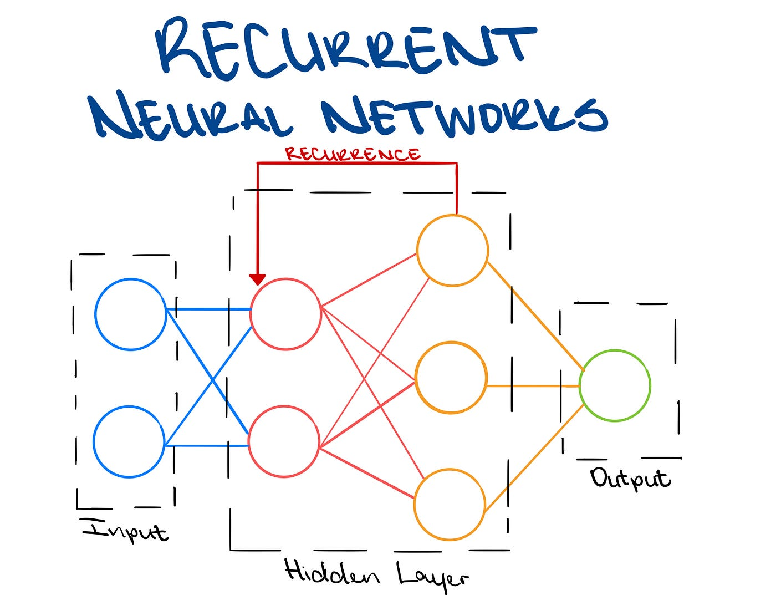
Recurrent Neural Networks (RNNs):
RNNs process sequential data like text, remembering previous inputs.
They are useful for handling streaming data and capturing language dependencies.
RNNs excel in real-time sentiment analysis tasks.

Slide 10
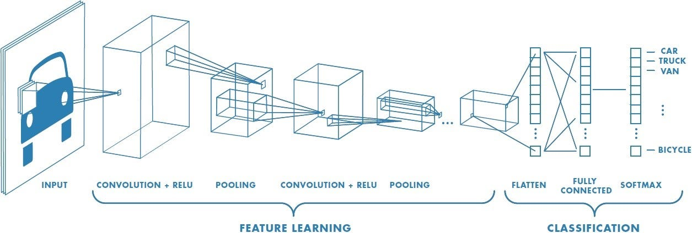
Convolutional Neural Networks (CNNs):
CNNs are known for image processing, but they work for text too.
They detect patterns in streaming text data for sentiment analysis.
CNNs efficiently analyze sentiments in real-time.

Slide 11
Performance Metrics for Real-time Sentiment Analysis
Evaluating real-time sentiment analysis: Assessing accuracy and response time.
Performance Metrics: Efficiency indicators like throughput, latency, and accuracy.

Slide 12
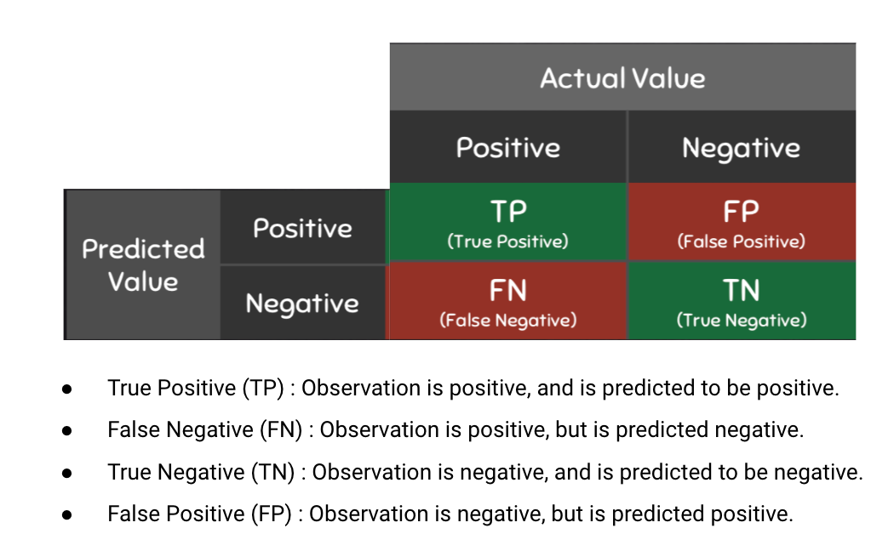

Slide 13
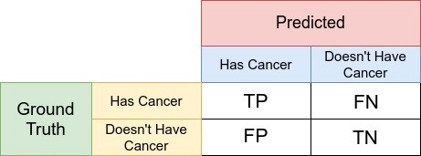
Example:

Slide 14
Real-world Applications
Monitoring Social Media Sentiment: Real-time analysis of tweets, comments, and interactions to understand public sentiment.
Brand Reputation Management: Detecting real-time shifts in sentiment towards brands or products.
Crisis Management: Using real-time sentiment analysis during emergencies to assess public response.

Slide 15
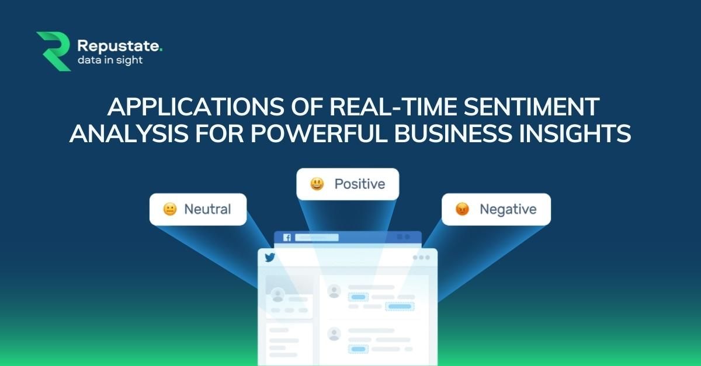

Slide 16
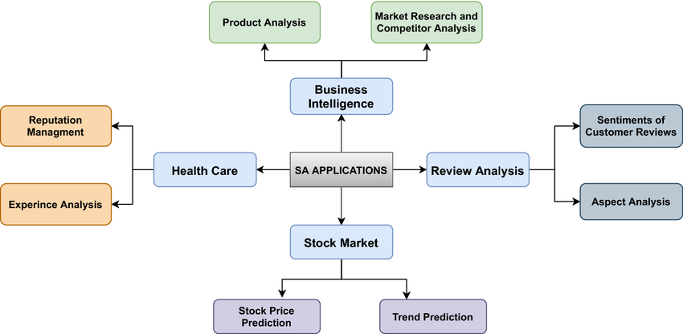
Real-world Applications

Slide 17
Future Directions
Advancements in real-time sentiment analysis: New techniques and technologies.
NLP and Deep Learning Integration: Improving emotion detection in real-time.
Handling Multimodal Streaming Data: Analyzing text, images, and audio for better sentiment analysis.

Slide 18
Conclusion
Importance of real-time sentiment analysis: A summary of its significance on streaming data.
Techniques and challenges in real-time sentiment analysis: Understanding how it works in real-time scenarios.

Slide 19
References
Ahmed, N., & Mahmood, A. N. (2021). Real-Time Sentiment Analysis of Twitter Streaming Data using Machine Learning. In 2021 IEEE 10th Annual Information Technology, Electronics and Mobile Communication Conference (IEMCON) (pp. 1-6). IEEE.
Bifet, A., & Holmes, G. (2010). Mining big data in real time with Twitter storm. Proceedings of the 16th ACM SIGKDD International Conference on Knowledge Discovery and Data Mining, 747-756. doi: 10.1145/1835804.1835890.
Chen, K., & Hsieh, C. (2020). Real-Time Sentiment Analysis on Twitter Streaming Data with Spark and Kafka. In Proceedings of the International Conference on Big Data and Advanced Wireless Technologies (pp. 10-18). ACM.
Cottrell, M., & Patel, K. (2016). Real-time sentiment analysis of Twitter data using Spark and Elasticsearch. Proceedings of the 7th ACM SIGSPATIAL International Workshop on GeoStreaming, 1-4. doi: 10.1145/3007540.3007544.

Slide 20
Thank you !

